Slide 1
Craft of Data Visualization
Visualizing Billions of Data Points: Doing It Right
Alexey Zaytsev,
Skoltech, CDISE
18 January
Slides are based on http://go.continuum.io/visualizing-billions-data-points/

Slide 2
Overview
Visualizing big data — what is the problem?
Datashading
Datasets:
10 million points of NYC Taxi data
3 billion points of OpenStreetMap data
300 million points of US Census data

Slide 3

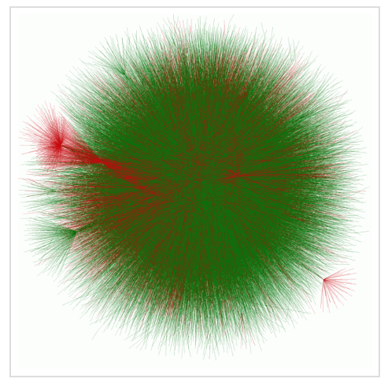
Billions and billions…
https://networkscience.wordpress.com/2016/06/22/no-hairball-the-graph-drawing-experiment/

Slide 4
Big data magnifies small problems
Big data presents storage and computation problems
More importantly, standard plotting tools have problems that are magnified by big data:
Overdrawing/Overplotting
Saturation
Undersaturation
Binning issues
We’ll first explain these problems, and then present datashading technique to address them.

Slide 5
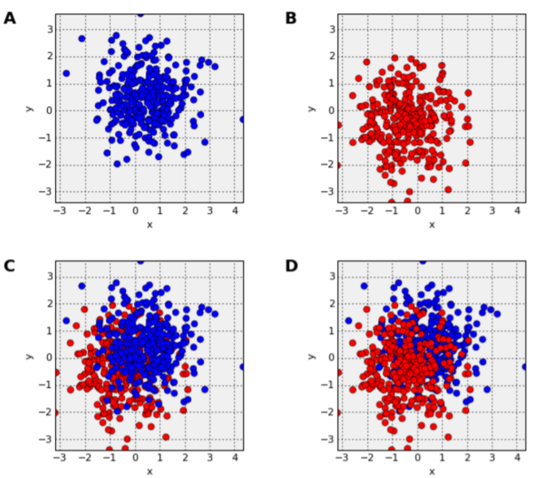
Overdrawning
For a scatterplot, the order in which points are drawn is very important
The same distribution can look entirely different depending on plotting order
Last data plotted overplots

Slide 6
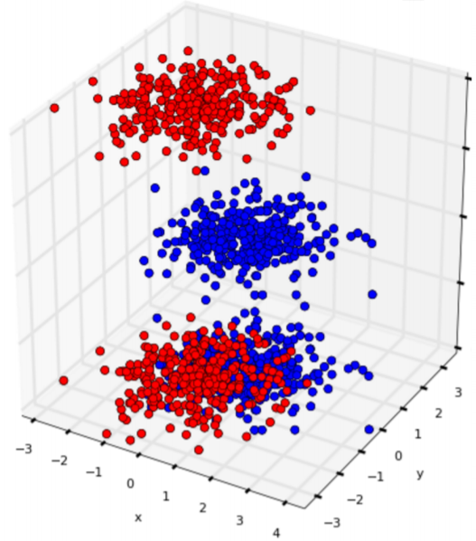
Overdrawning
Underlying issue is just occlusion
Same problem happens with one category, but less obvious
a Can prevent occlusion using transparency

Slide 7
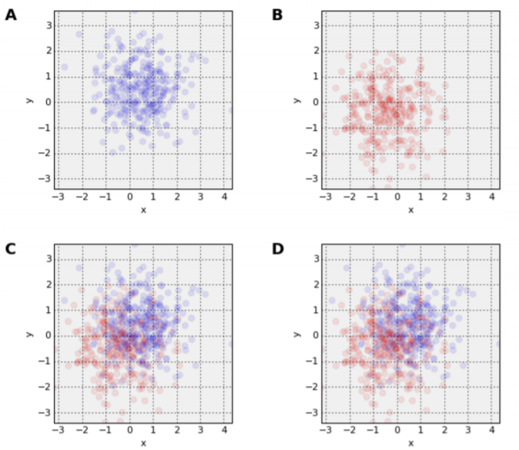
Saturation
For alpha = 0.1, up to 10 points can overlap before saturating the available brightness
Now the order of plotting matters less
After 10 points, first-plotted data still lost
For one category, 10, 20, or 2000 points overlapping will look identical

Slide 8
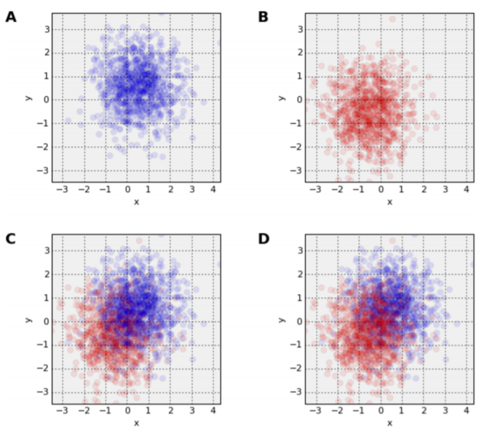
Saturation
Same alpha value, more points:
Now is highly misleading
alpha value depends on size, overlap of dataset
Difficult-to-set parameter, hard to know when data is misrepresented

Slide 9
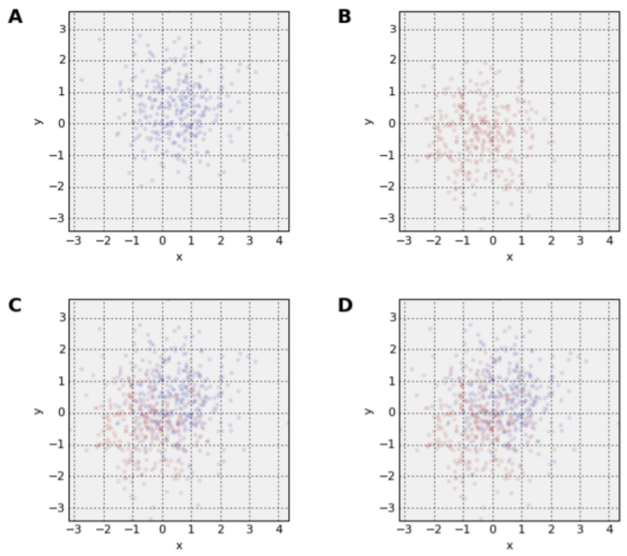
Saturation
Can try to reduce point size to reduce overplotting and saturation
Now points are hard to see, with no guarantee of avoiding problems
Another difficult-to-set parameter
For really big data, scatterplots start to become very inefficient: many points per pixel — may as well be binning by pixel

Slide 10
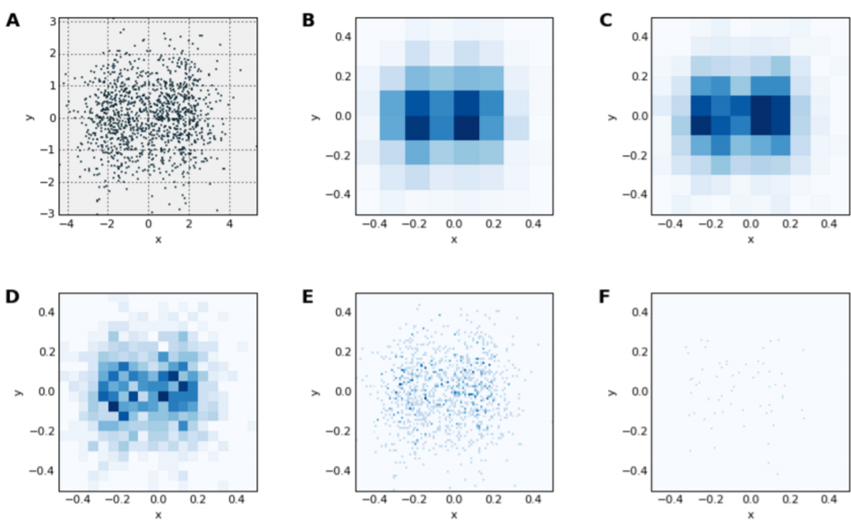
Binning
Can use heatmap instead of scatter
Avoids saturation by auto-ranging on bins
Result independent of data size
Here two merged normal distributions look very different at different binning
Another difficult-to-set parameter

Slide 11
Main challenges while plotting big data
When exploring really big data, the visualization is all you have — there’s no way to look at each of the individual data points
Common plotting problems can lead to completely incorrect conclusions based on misleading visualizations
Slow processing makes trial and error approach ineffective
When data is large, you don’t know when the plot is lying.

Slide 12
Datashading
Flexible, configurable pipeline for automatic plotting
Prevents overplotting, saturation, and undersaturation •
Mitigates binning issues by interactivity, even of very large datasets on ordinary machines
Allows rapid iteration of visual styles & configs, interactive selections and filtering, to support data exploration

Slide 13
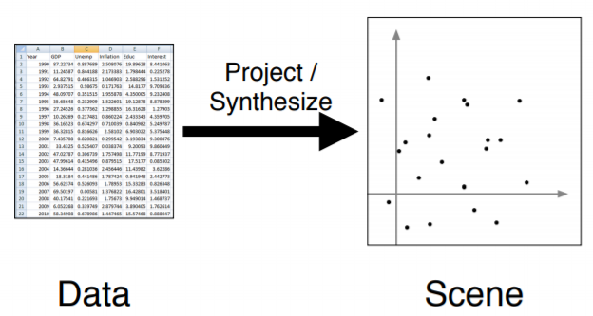
Datashading pipeline starts with projection
Stage 1: select variables (columns) to project onto the screen
Data often filtered at this stage

Slide 14
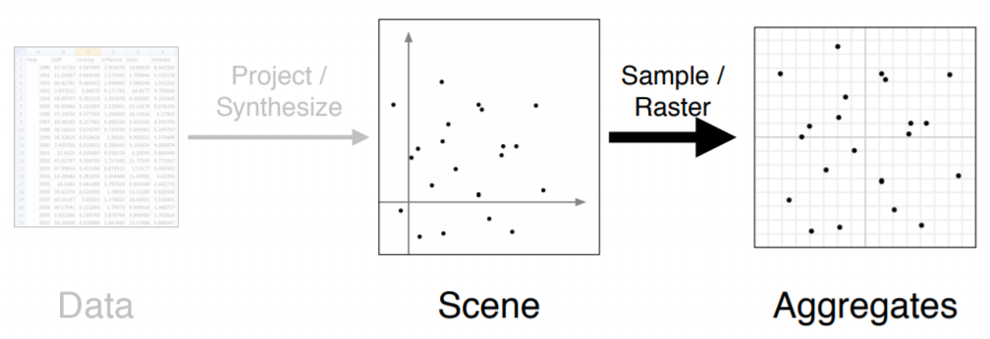
Datashading pipeline continues with aggregation
Stage 2: Aggregate data into a fixed set of bins
Each bin yields one or more scalars (total count, mean, stddev, etc.)

Slide 15
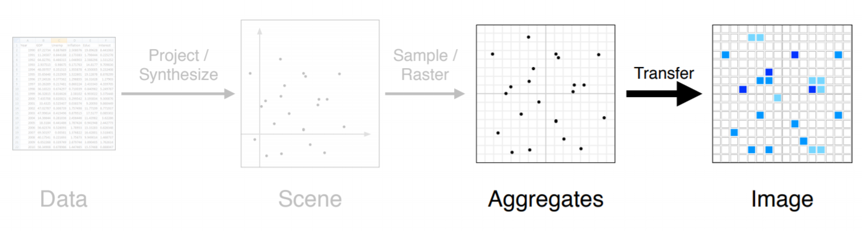
Datashading pipeline ends with transfer
Stage 3: Transform data using one or more transfer functions, culminating in a function that yields a visible image
Each stage can be replaced and configured separately

Slide 16
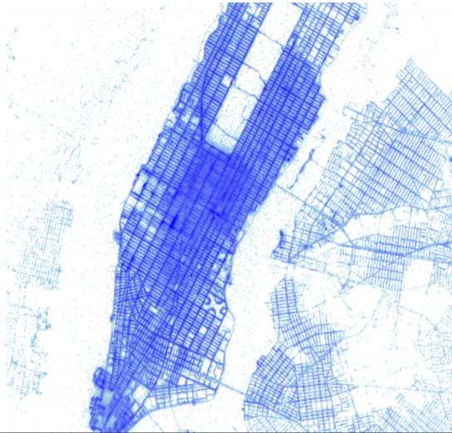
NYC taxi data
Data for 10 million New York City taxi trips
Even 100,000 points gets slow for scatterplot
Parameters usually need adjusting for every zoom
True relationships within data not visible in std plot
Datashading automatically reveals the entire dataset, including outliers, hot spots, and missing data

Slide 17
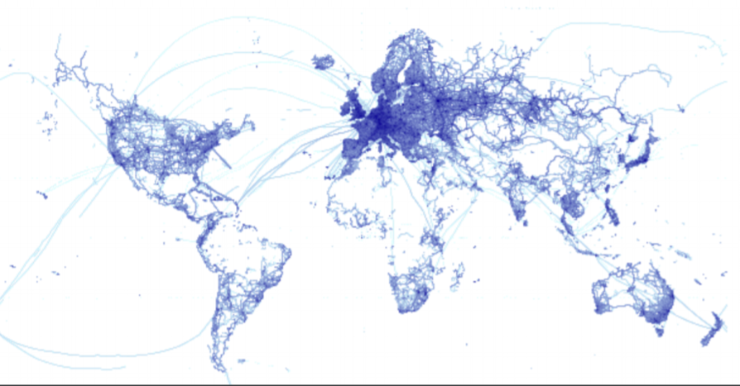
Billion OSM points
Open Street Map data:
About 3 billion GPS coordinates
https://blog.openstreetmap.org/ 2012/04/01/bulk-gps-point-data/
This image was rendered in one minute on a standard MacBook with 16 GB RAM
Renders in 7 seconds on a 128GB Amazon EC2 instance

Slide 18
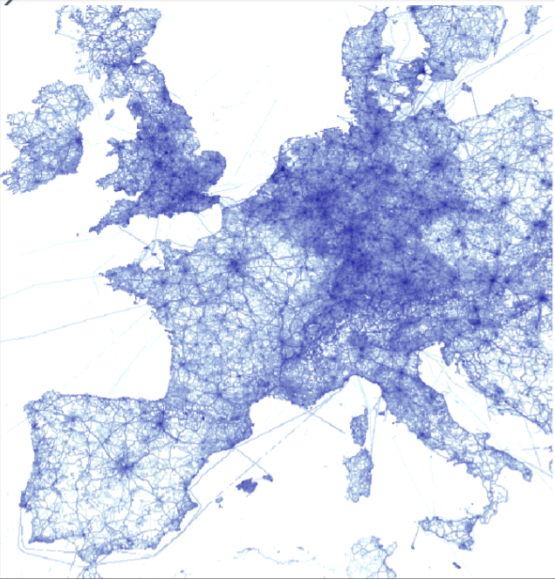
Billion OSM points
OSM database is 40GB, larger than the 16GB RAM on this machine
Fast out-of-core operation powered by: •
Numba: generates fast C and GPU code from Python source
Dask: Parallelizes tasks
datashader source code is all Python

Slide 19
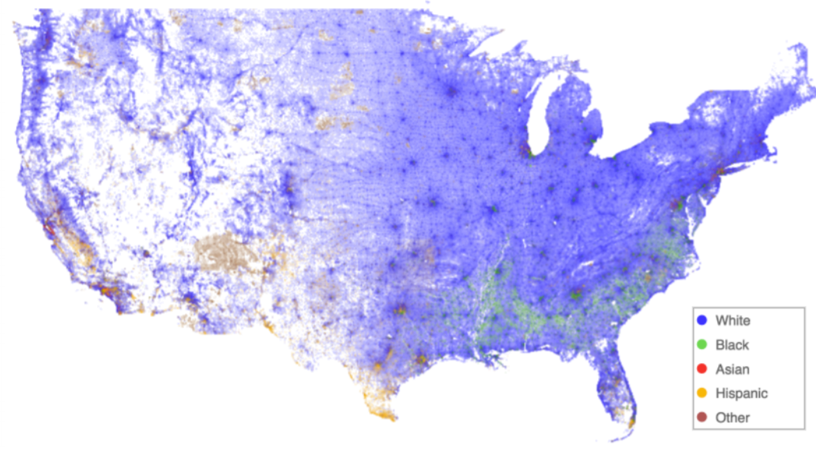
300 million points Census data
One point per person
300 million total
Categorized by race
Datashading shows faithful distribution per pixel

